Slide 2
Massive virtual textures for games: Direct3D tiled resources
Matt Sandy
Program Manager – Direct3D
4-063

Slide 3
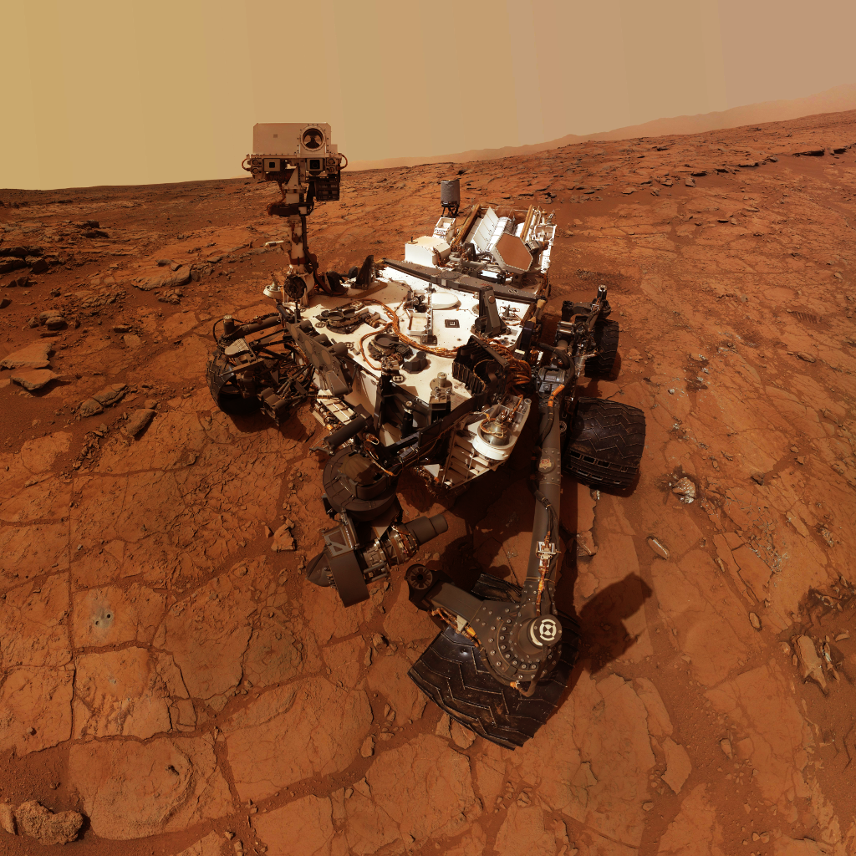
Agenda
The problem with textures.
Review existing solutions.
API deep dive.
Demos.

Slide 4
The problem with textures

Slide 5
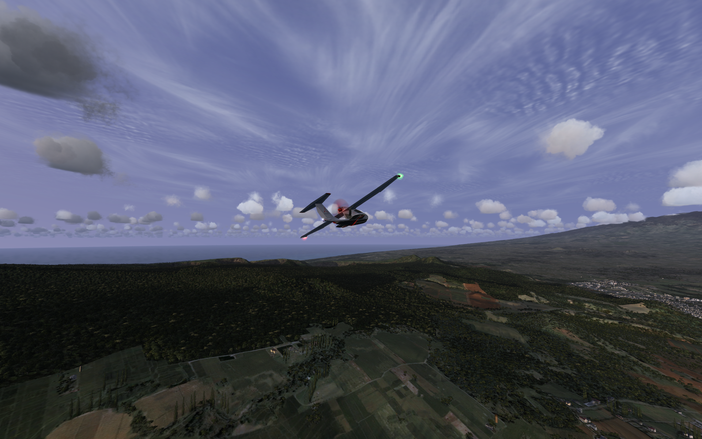
Gamers want expansive worlds
Vehicle (100MB)
Town (1GB)
House (10MB)
Terrain (10GB)
But they come at a cost…

Slide 6
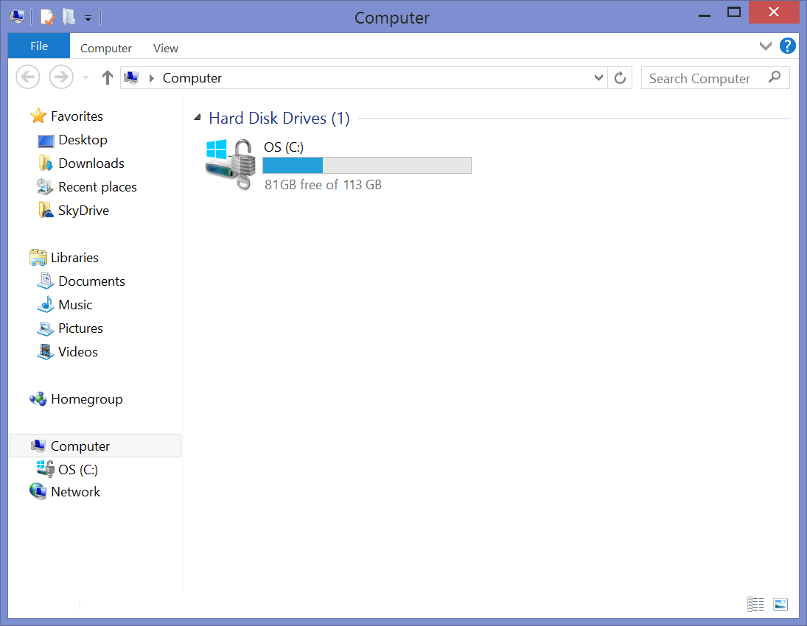
Textures are big

Slide 7
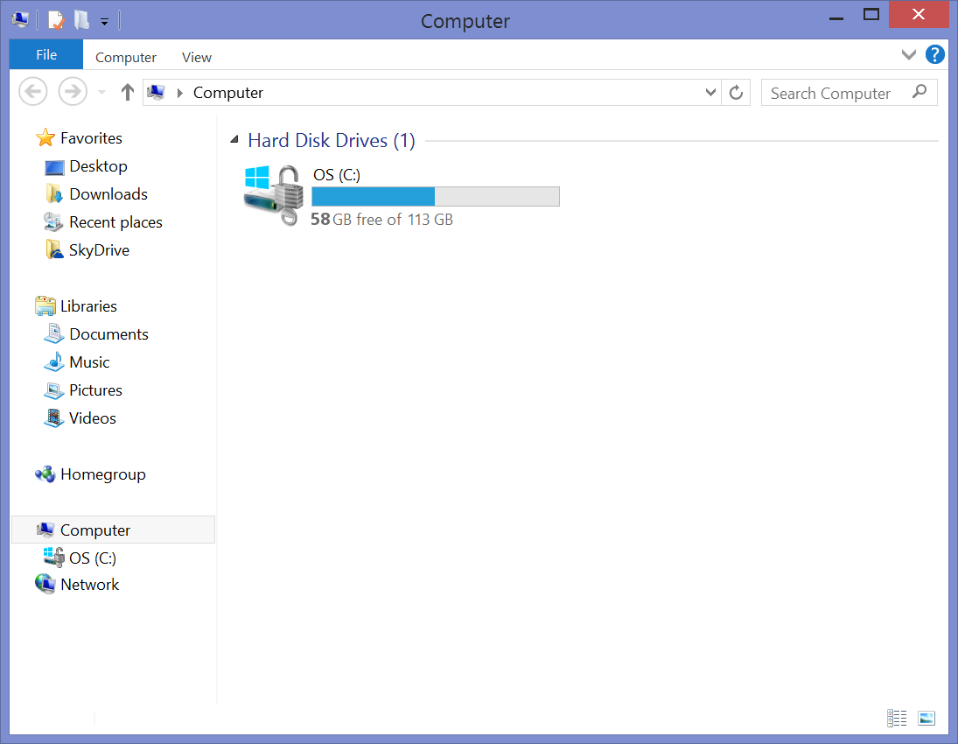
Textures are big
23GB
GPU
Textures
Everything else

Slide 8
Textures are big
So what?
No way to have all 10+GB in memory simultaneously.
Typically, only a small fraction is needed at a time.
Display is only 1920 x 1080 ≈ 2M pixels.
So how do we get the right texels onto the GPU?

Slide 9
Existing solutions

Slide 10
Texture streaming
What is it?
Stream textures as needed by the immediate region.
Depending on player position + view, load new resources and unload old ones.

Slide 11
Texture streaming
Problems with this approach…
Stream granularity is whole resources (still tens of MB).
5GBps (PCIE effective bandwidth)/60Hz ≈ 85MB/frame.
May need artificial transition regions to ease loading.
Often only need a small region of a texture, so bandwidth and memory capacity are wasted.

Slide 12
Software tiling
What is it?
Stream texture regions (tiles) as needed.
Store lookup tables as textures.
Filtering is done manually in pixel shader.

Slide 13
Software tiling
How does it work?
Loaded
data values
Manual
interpolation
Lookup texture
Data texture
 | A | B | C
 |  | H | F | G
 |  |  | J | K | L | W
 |  | O | P | Q | R
 |  |  | N | T | U
 |  |  |  | V | S
 |  |  |  |  | Y | Z
Bilinear filtering ☺
Trilinear filtering 😐
Anisotropic filtering ☹

Slide 14
Software tiling
How does it work?
To avoid seams at tile boundaries, border regions with duplicate data are required.
Border must be large enough to cover all samples.
Overhead increases with larger formats and higher anisotropy.

Slide 15
Software tiling
How does it work?

Slide 16
Software tiling
We’re not quite there yet…
Requires manual filtering.
Anisotropic filtering is complicated.
Requires duplication in border regions.

Slide 17
Hardware solution

Slide 18
Hardware tiling
What is it?
Stream texture regions (tiles) as necessary.
Program hardware page tables to perform indirection.
Same approach as software tiling, but hardware-accelerated!

Slide 19
Hardware tiling
How does it work?
Hardware
filtering units
Page table
Physical memory
Virtual texture
(UV space)
A | X
B | 1
C | X
D | 6
E | 4
F | 2
G | X
H | X
I | 5
0
1
2
3
4
5
6
7
A | B | C
D | E | F
G | H | I
Bilinear filtering ☺
Trilinear filtering ☺
Anisotropic filtering ☺

Slide 20
Hardware tiling
Benefits over software.
✓
✓
✓
✓
Can use regular sampling.
Anisotropic filtering.
No border regions required.
Page-table lookup is free.

Slide 21
Hardware solution in DirectX: Tiled resources

Slide 22
DirectX Tiled Resources
Key API concepts…
Tile Pool.
Buffer of 64KB physical tiles.
Tiled Resource.
Texture2D or Buffers created with the TILED flag.
APIs for many common scenarios:
Update/copy tile mappings.
Update/copy tiles.
Resize tile pool.
Insert dependency barrier.
New shader instructions for checking residency.

Slide 23
Creating the tile pool
CreateBuffer(D3D11_BUFFER_MISC_TILE_POOL)
Tile pool
pTilePool->Resize(10)
0
1
2
3
4
5
6
7
8
9

Slide 24
Creating a tiled resource
CreateTexture2D(D3D11_RESOURCE_MISC_TILED)
Tile pool
0
1
2
3
4
5
6
7
Tiled texture2D
Page table
A | B | C | D
E | F | G | H
I | J | K | L
M | N | O | P
A |  | B |  | C |  | D
E |  | F |  | G |  | H
I |  | J |  | K |  | L
M |  | N |  | O |  | P
8
9

Slide 25
Updating tile mappings
UpdateTileMappings(box A-F→5, linear L-N→0)
Tile pool
0
1
2
3
4
5
6
7
Tiled texture2D
Page table
A | B | C | D
E | F | G | H
I | J | K | L
M | N | O | P
A |  | B |  | C |  | D
E |  | F |  | G |  | H
I |  | J |  | K |  | L
M |  | N |  | O |  | P
A | 5 | B | 6 | C |  | D
E | 7 | F | 8 | G |  | H
I |  | J |  | K |  | L | 0
M | 1 | N | 2 | O |  | P
8
9

Slide 26
Updating tile contents
Tile pool
0
1
2
3
4
5
6
7
Tiled texture2D
Page table
A | B | C | D
E | F | G | H
I | J | K | L
M | N | O | P
A | B | C | D
E | F | G | H
I | J | K | L
M | N | O | P
A | 5 | B | 6 | C |  | D
E | 7 | F | 8 | G |  | H
I |  | J |  | K |  | L | 0
M | 1 | N | 2 | O |  | P
8
9

Slide 27
Updating tile contents
UpdateTiles( box A-F = pBlueGradientData )
Tile pool
0
1
2
3
4
5
6
7
Tiled texture2D
Page table
A | B | C | D
E | F | G | H
I | J | K | L
M | N | O | P
A | B | C | D
E | F | G | H
I | J | K | L
M | N | O | P
A | 5 | B | 6 | C |  | D
E | 7 | F | 8 | G |  | H
I |  | J |  | K |  | L | 0
M | 1 | N | 2 | O |  | P
8
9

Slide 28
Updating tile contents
UpdateTiles( box A-F = pBlueGradientData )
Tile pool
UpdateTiles( linear L-N = pRedGradientData )
0
1
2
3
4
5
6
7
Tiled texture2D
Page table
A | B | C | D
E | F | G | H
I | J | K | L
M | N | O | P
A | B | C | D
E | F | G | H
I | J | K | L
M | N | O | P
A | 5 | B | 6 | C |  | D
E | 7 | F | 8 | G |  | H
I |  | J |  | K |  | L | 0
M | 1 | N | 2 | O |  | P
8
9
Regular Update*, Copy* APIs work, too…

Slide 29
Using the tiled resource
Tiled resources – use them as you would a normal resource.
Just a normal texture now.
Can Sample() in shaders.
Use your existing shader code.

Slide 30
Using the tiled resource
But there’s more –
new HLSL instructions!
Sample with feedback (returns residency status).
Clamped sampling instructions.
Minimum and maximum filter variants.
Use this to drive the clamp value.

Slide 31
A note on 2D tile shapes
Every tile is 64KB, but layout depends on the format’s texel size.
 | 1x MSAA | 4x MSAA
4bpp | 512 x 256 | 256 x 128
8bpp | 256 x 256 | 128 x 128
16bpp | 256 x 128 | 128 x 64
32bpp | 128 x 128 | 64 x 64
64bpp | 128 x 64 | 64 x 32
128bpp | 64 x 64 | 32 x 32

Slide 32
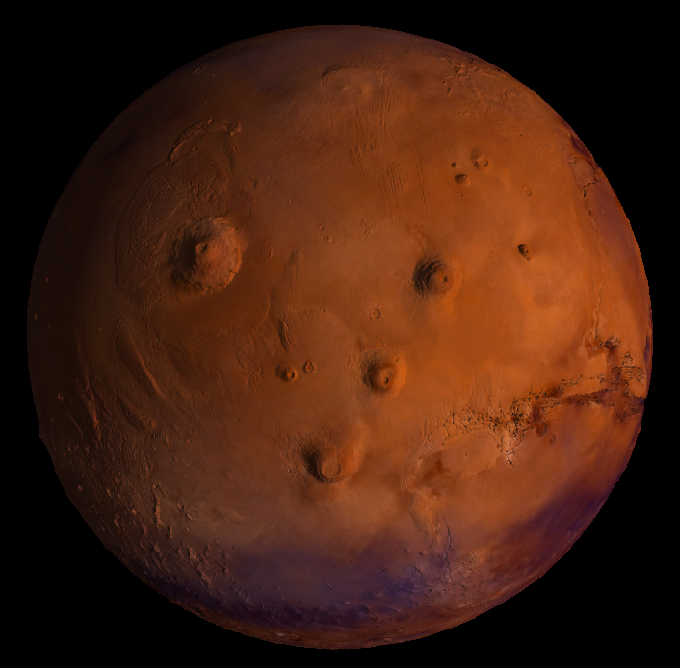
Demo: Mars

Slide 33
About the demo
Get the code!
Two 16k tiled texture cubes.
Diffuse (BC1 UNORM): 6 x 16384² x 0.5bpp x 1.333 = 1GB
Normal (BC5 SNORM): 6 x 16384² x 1.0bpp x 1.333 = 2GB
Shared tile pool: 256 x 64KB tiles = 16 MB (<1% of assets)

Slide 34
Picking a tile pool size
Depends primarily on format, layering, and display size.
Pool size = width x height x ∑(layer format sizes) x 4 x 1.333
Example: 1920 x 1080 x (4bpp + 8bpp) x 4 x 1.333 ≈ 16MB

Slide 35
Picking a tile pool size
Depends primarily on format, layering, and display size.
Pool size = width x height x ∑(layer format sizes) x 4 x 1.333
Example: 1920 x 1080 x (4bpp + 8bpp) x 4 x 1.333 ≈ 16MB
4 (MIP N-1) x
1.333 (MIP chain)

Slide 36
Usage examples

Slide 37
Tiled terrain
Use the same system for aircraft through infantry.
Terrain layers can be 16k x 16k.
Stream in detail tiles as needed.
Based on player camera.
Based on game events.

Slide 38
Shadow mapping
Better shadows without the cost.
Allows ultra high-density shadow buffers.
Map only tiles that contain relevant data.
Map only tiles that cover shadowed objects in the camera view.
Use previous frame data to approximate where detail is needed.

Slide 39
Demo: Shadows

Slide 40
Atlasing substitute
Who doesn’t like free memory?
One reason to use atlases is that they save on texture footprint, taking advantage of spatial locality of the data.
With tiled resources, just leave unused tiles unmapped.

Slide 41
And many more…
Some ideas to get you started…
Image editors.
Map viewers.
Data visualization tools.
Sparse data set manipulation.

Slide 42
A note on residency management
This is important!
Residency management is on the critical path for better utilization of hardware tiling.
Some ideas for management:
Dedicated low-resolution sampling pass.
Combine with deferred rendering passes.
Drive updates using game-specific state knowledge.
Use your existing asset LOD system to help.
Use middleware…

Slide 43

Middleware spotlight: Granite
www.graphinesoftware.com
Charles Hollemeersch, PhD
Co-founder and CTO, Graphine

Slide 44

What is Granite
Middleware product for game developers.
Library that integrates into the game.
Now supports Tiled Resources.

Slide 45

Demo: Island
Demo: Island
64k x 64k Terrain.
64k x 64k Terrain.

Slide 46
Why use Granite Middleware
Granite, handles your streaming.
Minimize latency.
Minimize texture cache size.
Minimize storage size.
Minimize production overhead.
Maximize unique texture data.

Slide 47
What does it do
Granite, manages your tiles.
Streaming
Multiple platforms
Multiple strategies (classic streaming, virtual texturing, …)
Multi-threaded disc I.O.
Multiple tiling back-ends (tiled esources, software DX9, GL ES)
Compression
Decode to GPU-ready formats (BCx)
Minimal on-disc footprint
Authoring
Handles tiling
Supports all common image formats & tools

Slide 48
Granite compression
Granite, get that massive amount shipped.
Advanced tile compression on disk.
Fast transcoding from disk format to DXT GPU tiles.
x
x

Slide 49
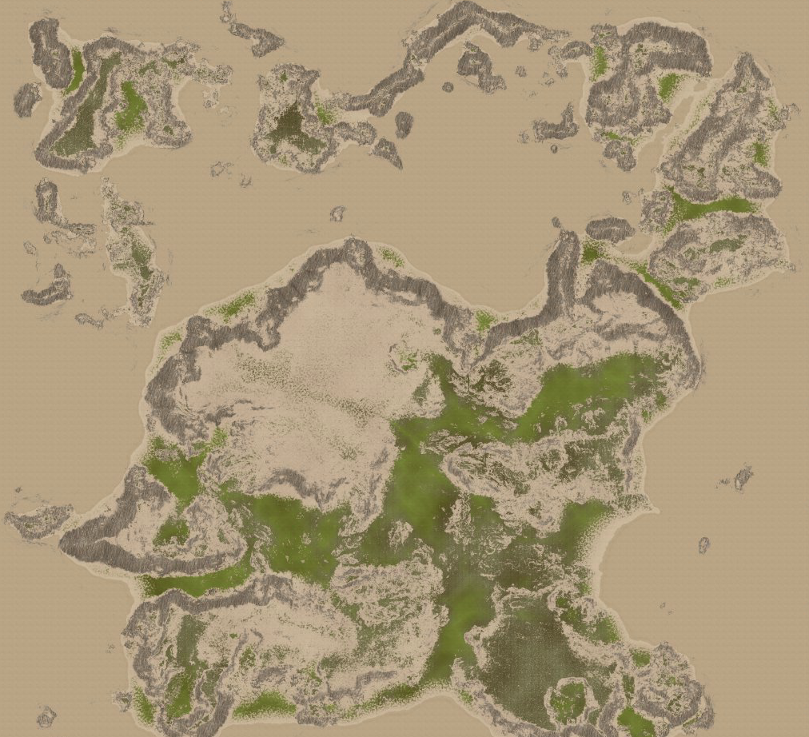
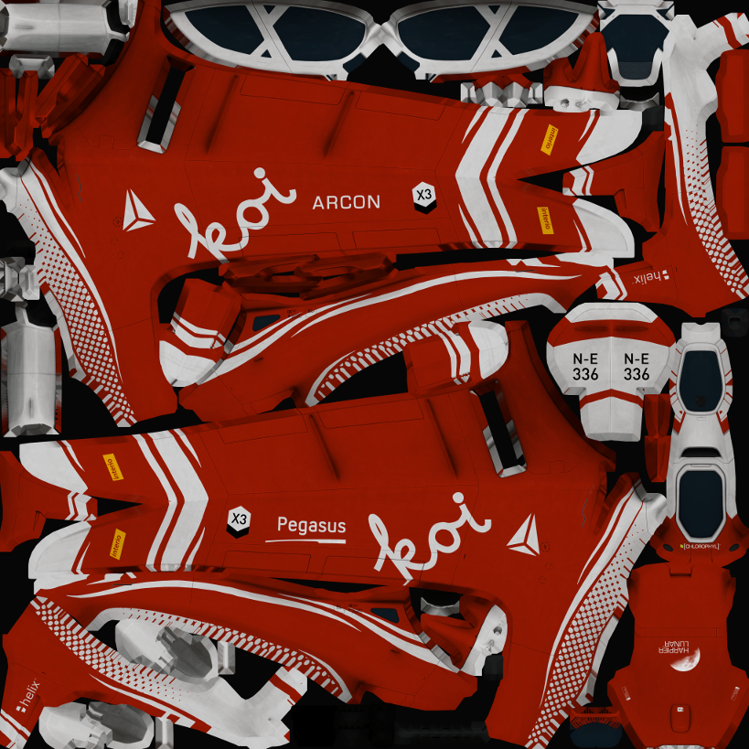
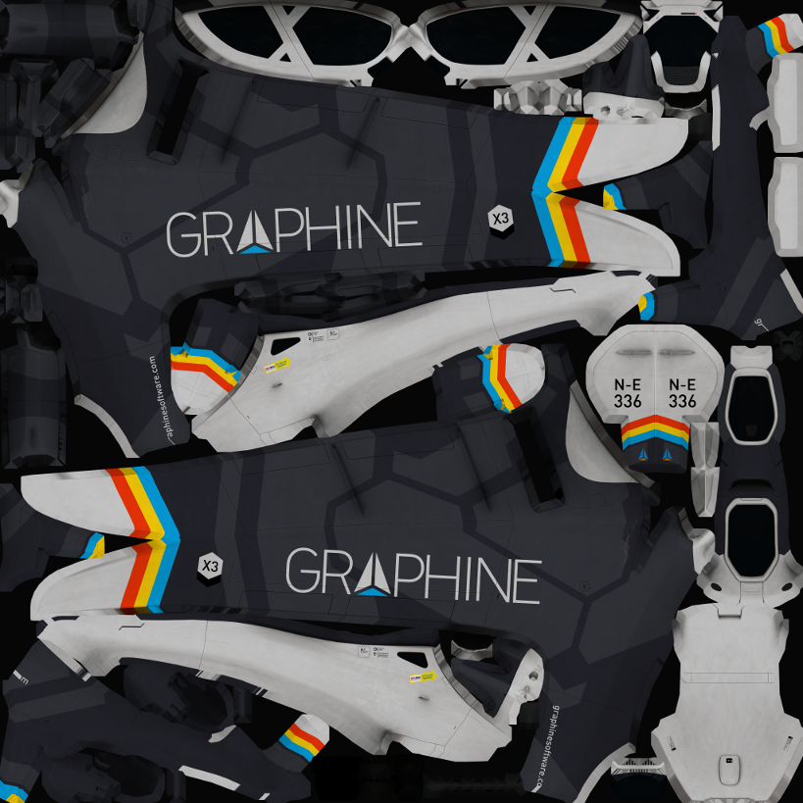
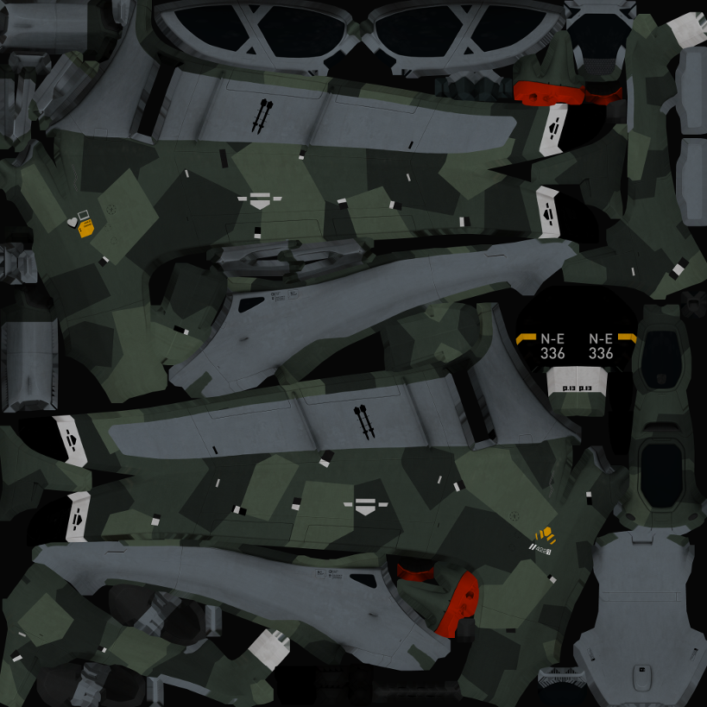



Granite runtime overview
Game
GPU
Granite Streaming
Granite Tiling Backend
Residency Analysis
Compression Decompression
Quartz Advanced
Compression
Software
Microsoft Tiled Resources
Streaming Runtime
OpenGL
Granite Tile File

Slide 50
Practical considerations tiled resources
Things to keep in mind when adopting.
Predicting tile residency.
Mipmap fallback.
Maximum surface size.
Performance benefits.

Slide 51
Predicting tile residency
No page faults on the GPU.
Hardware samples as if there was no tiling.
May access many pixels in the texture (think 16xAniso).
May access any mipmap level(s).
Predict tile residency.
Per pixel analysis of texture coordinates + texture tile topology.
Ideally done on the GPU itself.
Highly parallel.
Reuse existing data (meshes, …)
Need to predict all possibly accessed tiles.
Neighbors (bilinear & anisotropic).
Higher miplevels (tri-linear).

Slide 52
Mipmap fallback
No automatic fallback to lower mipmap level!
Even with prediction not everything is resident.
Disc latency (never block the rendering thread).
Approximations (lower resolutions, fixed budgets, …)
Developer handles this.
Return some sensible default (e.g., +inf for shadow maps).
Shader-based fall-back to a lower miplevel.
Island demo.
Keep an extra texture containing the mipindex of the lowest resident level.
Clamp sampling in tiled texture to this level.
A few shader instructions.

Slide 53
Maximum surface size
Maximum surface dimension is still 16384x16384.
Because of filtering precision requirements.
There is no strict limit on resource size.
Island allocates 16 GB resources (total 36 GB).
Emulate large textures using ‘meta-tiles’ via arrays.
Reuse your old software tricks at meta-tile borders.

Slide 54
Tiled resources performance benefits
No need for overlapping borders.
This saves ~20% disc and cache memory.
Simpler shader.
Software (4x Anisotropic) – 28 ops, 1 dep. read.
Hardware – 11 ops, 1 dep. read.
Hardware (16K array tiles) – 13 ops, 1 dep. read.

Slide 55
Takeaway
Stay ahead with advanced texture streaming.
Tiled resources exposes HW virtual memory.
Makes sampling easier.
Less shader work for filtering.
Granite, the ‘O.S.’ for virtual textures.
Scales to any amount of texture data on any platform.
Residency management and streaming.
7:1 additional compression over DXT5.
Streaming file format, with import tools and viewer.
Easy to integrate, even late in production.

Slide 56

www.graphinesoftware.com
Visit our website for the //build release
Come talk to us!
Retweet @GraphineSoft and WIN one of 10 copies of Dragon Commander (Larian Studios)

Slide 57
Review
Gamers want expansive worlds.
This requires massive amounts of texture data.
DirectX Tiled Resources exposes programmable hardware page tables.
Enables more efficient use of bandwidth and memory.
So you can commit more of it to adding detail and expanding the game world.

Slide 58
Resources
Windows 8.1 Preview
preview.windows.com
Windows 8.1 Preview SDK
preview.windows.com
Mars demo code
go.microsoft.com/fwlink/?LinkID=310136
Additional resources
go.microsoft.com/fwlink/?LinkID=311595
Graphine Software
www.graphinesoftware.com

Slide 59


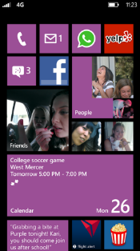
Evaluate this session
Required Slide
*delete this box when your slide is finalized
Your MS Tag will be inserted here during the final scrub.
Scan this QR code to evaluate this session and be automatically entered in a drawing to win a prize!

Slide 61
Appendix

Slide 62
Mars demo source data credits
NASA/JPL-Caltech
NASA/JPL-Caltech/Arizona State University
NASA/JPL-Caltech/MSSS
See demo code link for more information.

Slide 63
Other attributions
Agenda slide – Mars Science Laboratory
Credit: NASA/JPL-Caltech/MSSS
Source: http://www.nasa.gov/mission_pages/msl/multimedia/pia16937.html
License: http://www.nasa.gov/multimedia/guidelines/index.html

